Slide 1

Alcohol
So You Think You Know it All
TEST TIME!

Slide 2
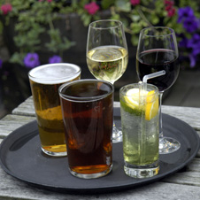
What is the name of the alcohol found in beer, wine and spirits?

Slide 3
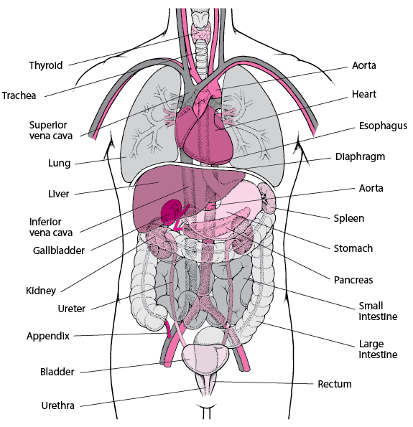
Alcohol mainly affects 2 key organs, what are they?

Slide 4

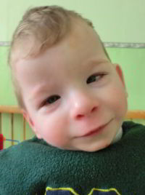
Drinking alcohol in pregnancy increases the risk of foetal alcohol syndrome. What are the symptoms?

Slide 5
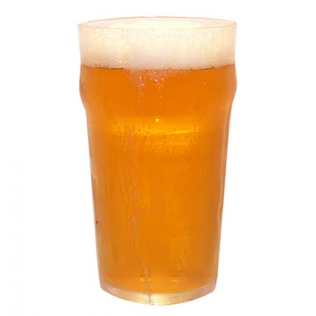
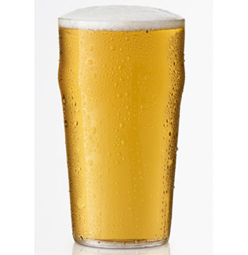
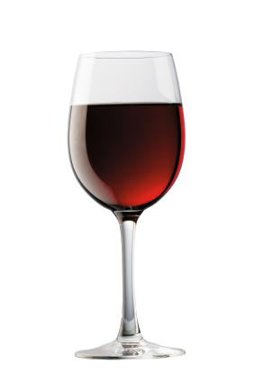
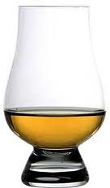
Put these drinks in order of the number of units of alcohol they contain; a shot of whisky (25 ml of 40%), a pint of cider (570 ml of 8%), a large glass of red wine (250 ml of 12%) and a pint of strong lager (570 ml of 5%)

Slide 6
Why do Drunks Get a Hangover?
Too much liquid in the brain
Dehydration makes the brain shrink away from the skull
A dodgy pint
Drunk people are more likely to bang their head
Fighting

Slide 7
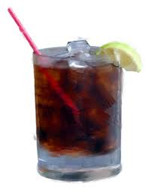
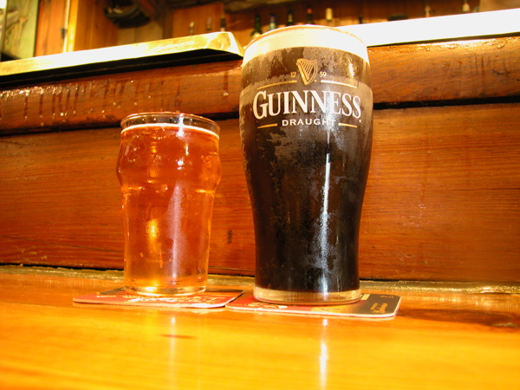
Which of these would be a safe amount for an adult female to drink in one evening?
2 x single rum and cokes
1 single rum and coke
A pint of Guinness and a half of cider
All 4 drinks

Slide 8
Which of these is a sign of severe liver damage?
The whites of the eyes have gone yellow
Bleeding that won’t stop
Tiredness and painful belly
Any or all of the above

Slide 9
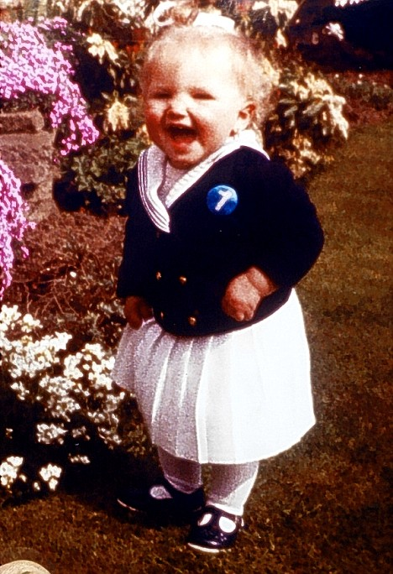

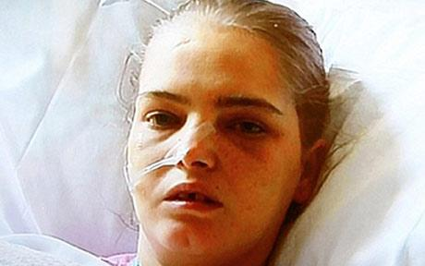
Stacy Rhymes started drinking at the age of 14. How old was she when she had drunk herself to death 18, 24, 30 or 36?

Slide 10
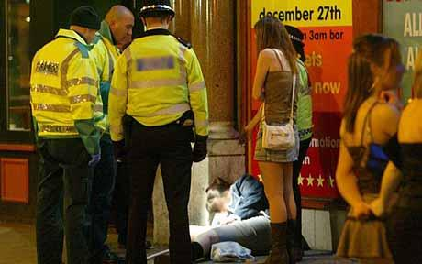
On average, how many people end up in UK hospitals after drinking alcohol on a typical night? 3000, 300, 30

Slide 11
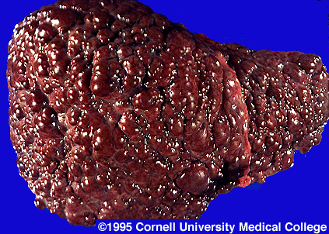
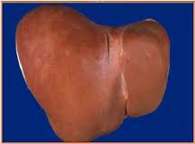
What is Wrong with the Liver on the Left

Slide 12
End of Test
Pass your paper left for marking

Slide 13
What is the name of the alcohol found in beer, wine and spirits?
Ethanol

Slide 14
Alcohol mainly affects 2 key organs, what are they?
Liver and Brain

Slide 15
Foetal Alcohol Syndrome
Poor growth in the womb and after birth
Muscle weakness and poor coordination
Problems in three or more major areas: thinking, speech, movement, or social skills
Heart defects
Facial Abnormalities
Risk of birth abnormality is 1 in 1000 without drinking and as high as 1 in 20 with drinking
There is NO safe level of drinking in pregnancy
There is no treatment

Slide 16
Put these drinks in order of the number of units of alcohol they contain; a shot of whisky (25 ml of 40%), a pint of cider (570 ml of 8%), a large glass of red wine (250 ml of 12%) and a pint of strong lager (570 ml of 5%)
1 unit
4.5 units
3 units
3 units

Slide 17
Why do Drunks Get a Hangover?
Too much liquid in the brain
Dehydration makes the brain shrink away from the skull
A dodgy pint
Drunk people are more likely to bang their head
Fighting

Slide 18
Which of these would be a safe amount for an adult female to drink in one evening?
1 single rum and coke
2 x single rum and cokes
The half of cider on its own would be OK as well

Slide 19
Which of these is a sign of severe liver damage?
The whites of the eyes have gone yellow
Bleeding that won’t stop
Tiredness and painful belly
Any or all of the above

Slide 20
Stacy Rhymes started drinking at the age of 14. How old was she when she had drunk herself to death 18, 24, 30 or 36?
24

Slide 21
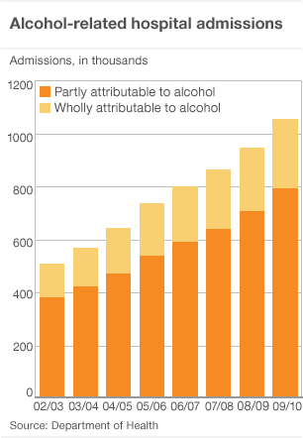
On average, how many people end up in UK hospitals after drinking alcohol on a typical night? 3000, 300, 30
1 million per year is 3000 per night!

Slide 22
What is Wrong with the Liver on the Left
Liver Cirrhosis
Scarring of the Liver
Healthy Liver

