Slide 1


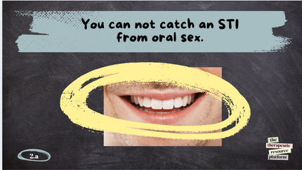
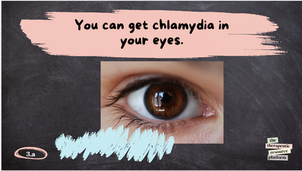








Sexually Transmitted Infections (STI): True or false, Myth Busters
Instruction page
Activity Type
General Activity Info
Age: 13-18+
Participation Style: Interactive group activity
Group play - solo points
Resource Format:
Game/quiz interactive
Slide show print & sort
This engaging activity challenges participants to distinguish facts from misconceptions about sexually transmitted infections (STIs). Through true or false statements, participants explore key information on STI transmission, prevention, and symptoms. Facilitator-led discussions provide accurate insights and dispel myths, promoting informed decision-making around sexual health. This activity is designed to be educational, interactive, and supportive of open conversations about sexual health.
Theme:
Sexual heath
Life skills
Challenge Level
MODERATE
Materials Needed
  Download the slideshow for a digital session.
  Flashcards for participants to display their answers.
  Alternatively, you can print and laminate the resources, allowing participants to sort them into two categories: true or false.
Step By Step Instructions
  Present each action/slide to the participants.
  Read each statement aloud or display it on the screen.
  Ask participants to hold up their "True" or "False" card or call out their answers.
  After each statement, reveal the correct answer and provide a brief explanation with a reference for clarity.
**Alternatively you can print and laminate the slides and have participants work in groups and sort them into true or false piles.
5. Discussion:
Encourage participants to ask questions or share their thoughts after each statement.
Clarify common misconceptions about STI transmission and prevention.
6. Wrap-Up:
  Summarize key learning points.
  Offer resources for further information, such as links to NHS sexual health advice or local sexual health clinics.
the
therapeutic
resource
platform

Slide 2



SEXUALLY TRANSMITTED INFECTIONS (STI): TRUE OR FALSE, MYTH BUSTERS
the
therapeutic
resource
platform

Slide 3





Only gay men can contract HIV in the Uk.
the
1.a
therapeutic
resource
platform

Slide 4

Only gay men can contract HIV in the Uk.
FALSE
False. Anyone can contract HIV, regardless of sexual orientation. However, HIV is more prevalent in certain communities, particularly among men who have sex with men (MSM) due to higher rates of unprotected sex, multiple partners, and a higher likelihood of encountering anal sex, which carries a higher risk of transmission. Education, prevention, and access to treatment are crucial for all communities. (NHS, "HIV and AIDS")
the
1.b
therapeutic
resource
platform

Slide 5

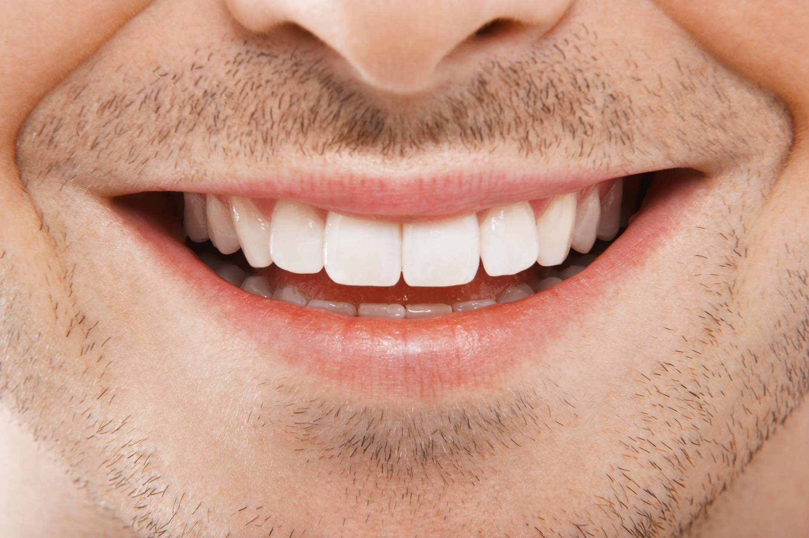

You can not catch an STI from oral sex.
the
therapeutic
2.a
resource
platform

Slide 6
You can not catch an STI from oral sex.
FALSE
False. You can catch STIs from oral sex, including herpes, gonorrhea, syphilis, and HPV. While the risk is lower than with vaginal or anal sex, it's still possible to transmit infections through oral-genital contact. (NHS, "Oral Sex and STIs")
the
therapeutic
2.b
resource
platform

Slide 7

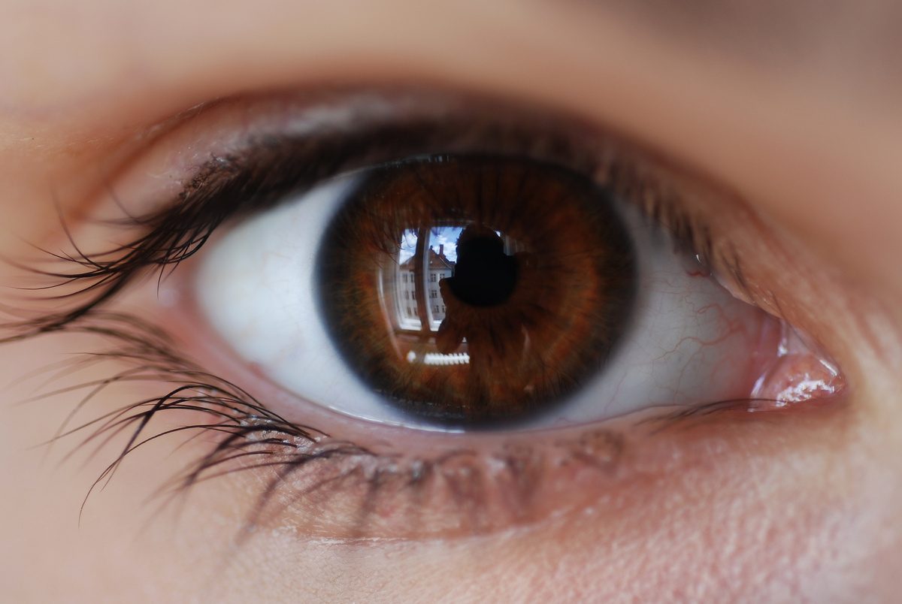


You can get chlamydia in your eyes.
the
3.a
therapeutic
resource
platform

Slide 8


You can get chlamydia in your eyes.
TRUE
True. Chlamydia can be transmitted to the eyes through contact with infected genital fluids, leading to a condition called conjunctivitis (eye infection). This is more likely through unprotected oral sex or touching the genital area and then touching the eyes. (NHS, "Chlamydia")
the
3.b
therapeutic
resource
platform

Slide 9



Aids has been cured.
the
4.a
therapeutic
resource
platform

Slide 10

Aids has been cured.
FALSE
No, AIDS has not been cured. However, antiretroviral therapy (ART) can effectively suppress HIV, the virus that causes AIDS, allowing people to live long and healthy lives without progressing to AIDS. A few rare cases of individuals being "functionally cured" have occurred through complex treatments like stem cell transplants, but these are not widely applicable. (NHS, "HIV and AIDS Treatment"; WHO, "HIV/AIDS")
the
4.b
therapeutic
resource
platform

Slide 11

You can get an STI from a toilet seat.
the
5.a
therapeutic
resource
platform

Slide 12
You can get an STI from a toilet seat.
FALSE
False: STIs are not spread through sitting on toilet seats. (NHS, "Sexually Transmitted Infections (STIs)")
the
5.b
therapeutic
resource
platform

Slide 13

Sharing sex toys without cleaning them can spread STIs
the
6.a
therapeutic
resource
platform

Slide 14
Sharing sex toys without cleaning them can spread STIs
TRUE
True: STIs like chlamydia and gonorrhea can be transmitted through shared sex toys if they aren't cleaned properly. (NHS, "Sexual Health")
the
6.b
therapeutic
resource
platform

Slide 15

You can’t get an STI if you only have oral sex.
the
therapeutic
7.a
resource
platform

Slide 16
You can’t get an STI if you only have oral sex.
FALSE
False: STIs like herpes, gonorrhea, and syphilis can be transmitted through oral sex. (NHS, "Oral Sex and STIs")
the
therapeutic
7.b
resource
platform

Slide 17
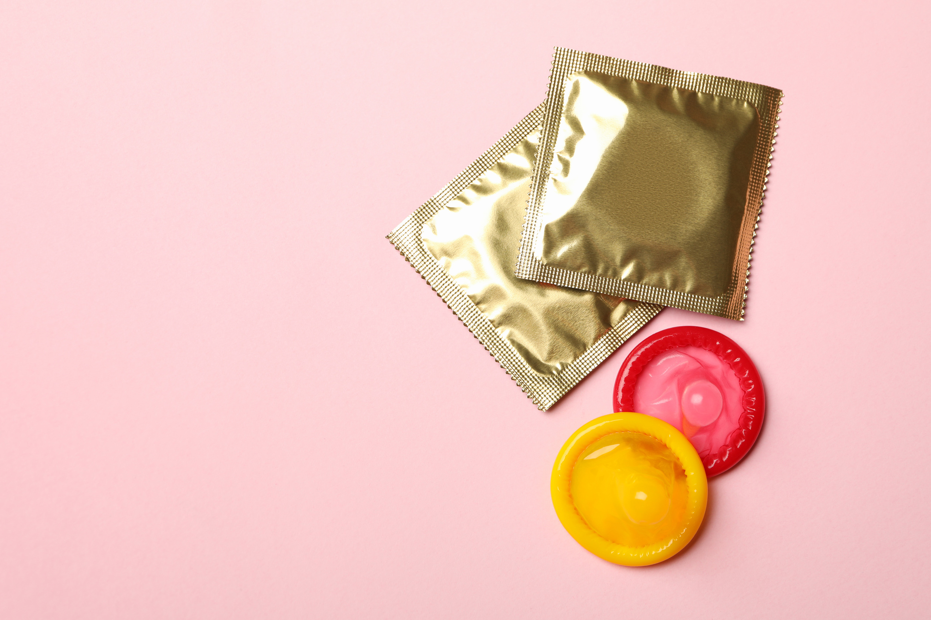
Using a condom always eliminates the risk of STIs.
the
8.a
therapeutic
resource
platform

Slide 18
Using a condom always eliminates the risk of STIs.
FALSE
False: Condoms significantly reduce the risk but do not offer 100% protection, especially against skin-to-skin infections like herpes and HPV. (NHS, "Contraception Guide")
the
8.b
therapeutic
resource
platform

Slide 19



You can have an STI without showing any symptoms.
the
therapeutic
9.a
resource
platform

Slide 20
You can have an STI without showing any symptoms.
TRUE
True: Many STIs, such as chlamydia, may not cause noticeable symptoms but can still be transmitted. (NHS, "STI Symptoms")
the
therapeutic
9.b
resource
platform

Slide 21
FALSE
the
therapeutic
resource
platform

Slide 22
TRUE
the
therapeutic
resource
platform

