Slide 1

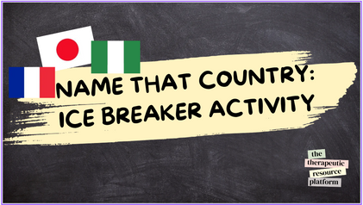

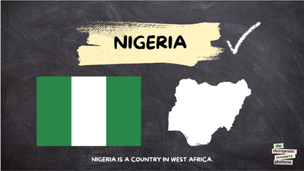






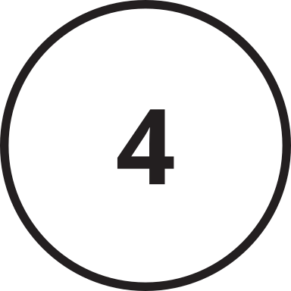

Name That Country! - Ice Breaker Activity
Instruction page
Activity Type
General Activity Info
Age: 8-18+
Participation Style: Interactive group activity
Resource Format:
Game/quiz - interactive
slide show print, and sort
Geography is an important subject for everyone. This simple icebreaker activity involves scrambled names of places, and participants must work together to decipher them!
Theme:
Ice breaker
Geography
Challenge Level
MODERATE
Materials Needed
  Download the slideshow
  Mini whiteboards and pens for answers.
Top Tip: You could also use laminated white paper and markers to make your very own reusable whiteboards.
Step By Step Instructions
  Dowlode the sldie show.
  Propvide partipants with a mini white board or you could have the call out or put heir hands up if they know the answer.
  Give them the answer and some infoamtion about the country.
the
therapeutic
resource
platform

Slide 2
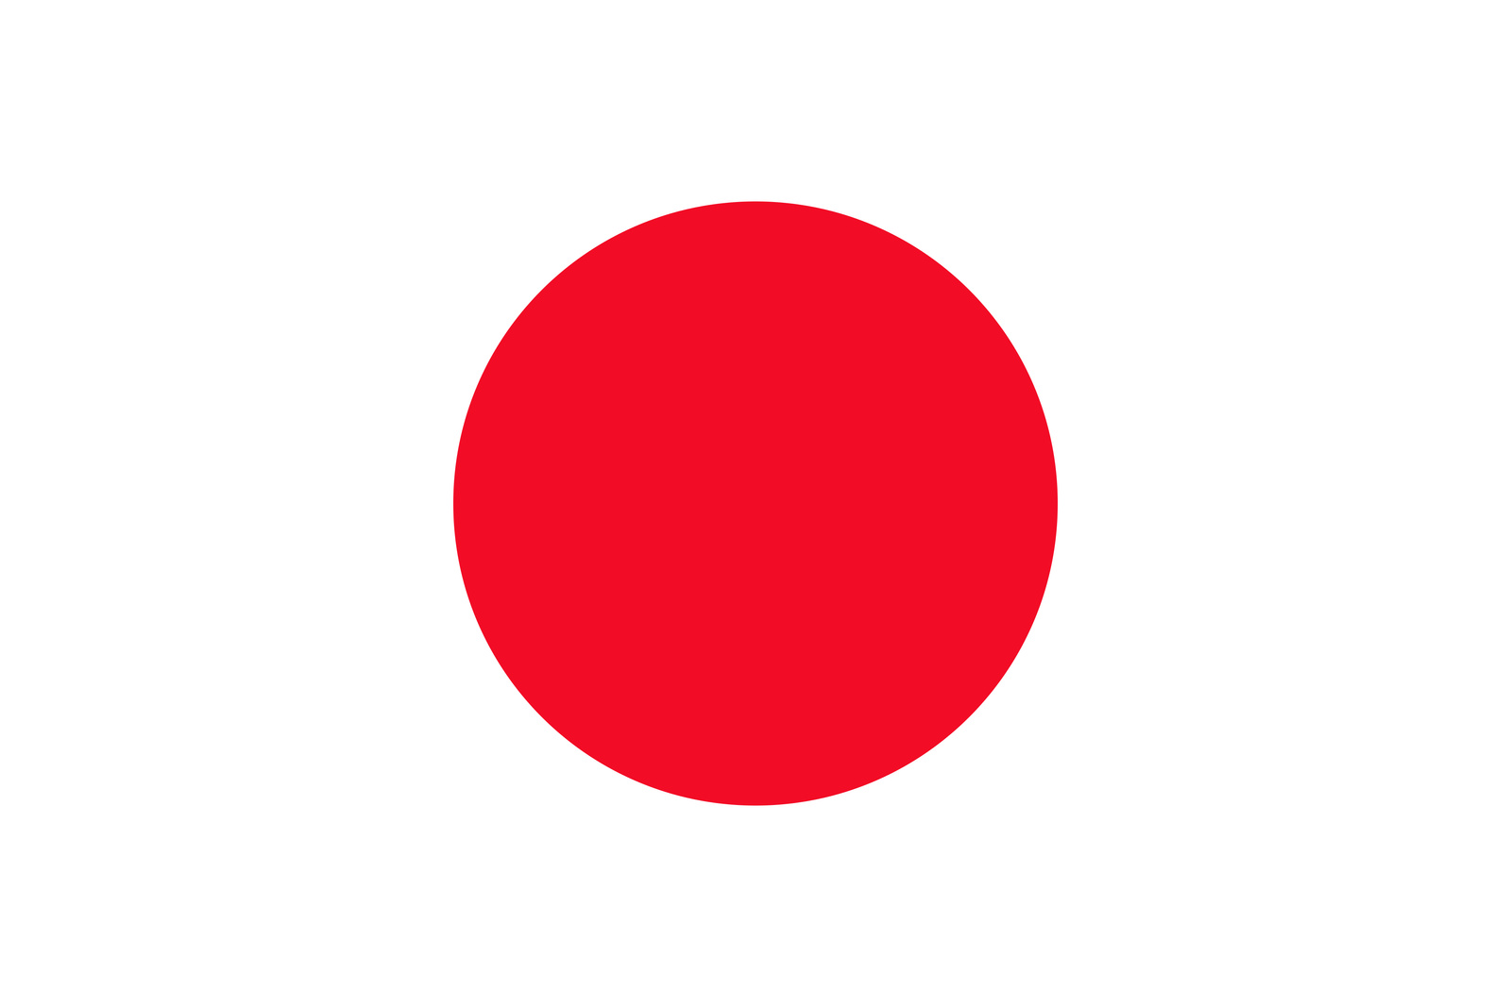



NAME THAT COUNTRY:
ICE BREAKER ACTIVITY
the
therapeutic
resource
platform

Slide 3



INREIAG
the
therapeutic
resource
platform

Slide 4



NIGERIA
the
therapeutic
resource
NIGERIA IS A COUNTRY IN WEST AFRICA.
platform

Slide 5

ITAUKW
the
therapeutic
resource
platform

Slide 6

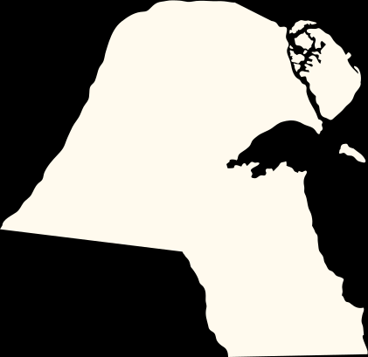

KUWAIT
the
therapeutic
resource
KUWAIT IS A COUNTRY IN THE MIDDLE EAST.
platform

Slide 7

ZTNAAINA
the
therapeutic
resource
platform

Slide 8
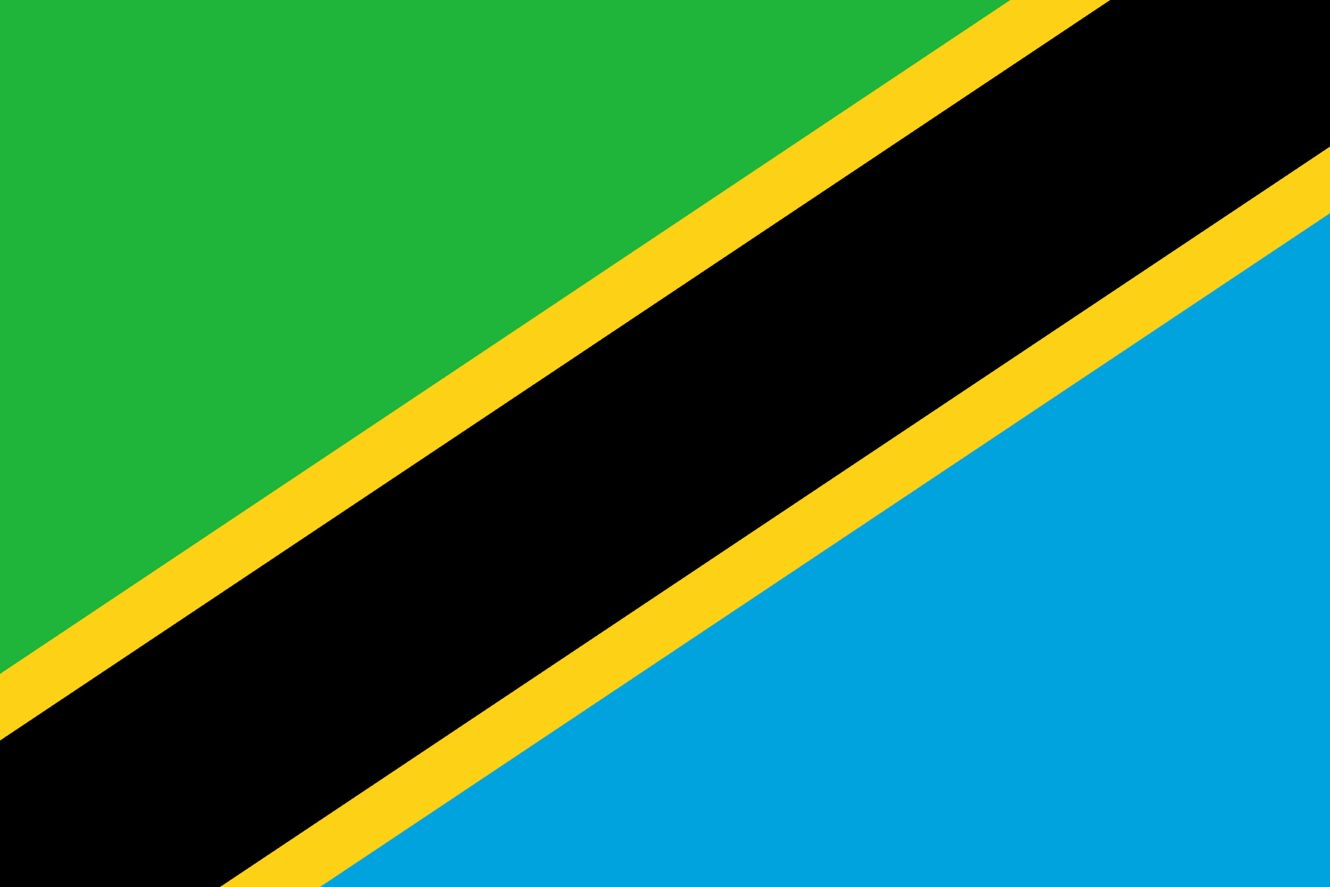

TANZANIA
the
therapeutic
resource
TANZANIA IS A COUNTRY IN EAST AFRICA.
platform

Slide 9

NETUID GNDOKMI
the
therapeutic
resource
platform

Slide 10


UNITED KINGDOM
the
therapeutic
resource
UNITED KINGDOM IS AN ISLAND COUNTRY IN WESTERN EUROPE, NORTHWEST OF MAINLAND EUROPE.
platform

Slide 11

NERFCA
the
therapeutic
resource
platform

Slide 12



FRANCE
the
therapeutic
resource
FRANCE IS A COUNTRY IN WESTERN EUROPE.
platform

Slide 13

SKALIOAV
the
therapeutic
resource
platform

Slide 14

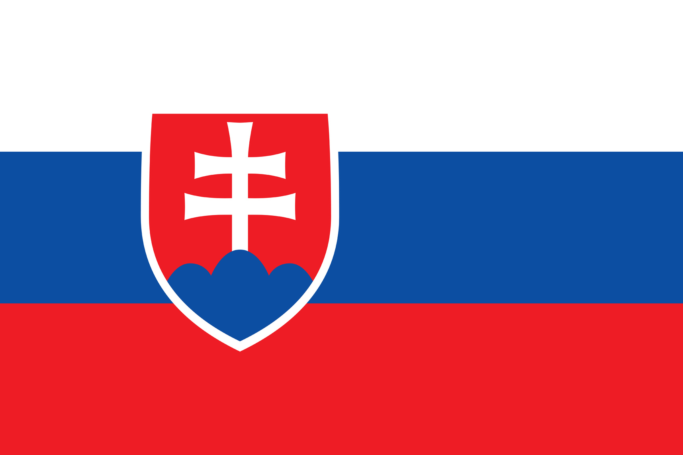

SLOVAKIA
the
therapeutic
resource
SLOVAKIA IS A COUNTRY IN EUROPE, IS A LANDLOCKED COUNTRY IN CENTRAL EUROPE.
platform

Slide 15
BIYLA
the
therapeutic
resource
platform

Slide 16

LIBYA
the
therapeutic
resource
LIBYA IS A COUNTRY IN THE MAGHRAB REGION NORTH AFRICA.
platform

Slide 17
EDUNIT ASTEST
the
therapeutic
resource
platform

Slide 18


UNITED STATES
the
therapeutic
resource
platform
UNITED STATES IS A COUNTRY IN NORTH AMERICA.

Slide 19
ANPAJ
the
therapeutic
resource
platform

Slide 20

JAPAN
the
therapeutic
resource
JAPAN IS AN ISLAND COUNTRY IN EAST ASIA.
platform

Slide 21

ZALBIR
the
therapeutic
resource
platform

Slide 22

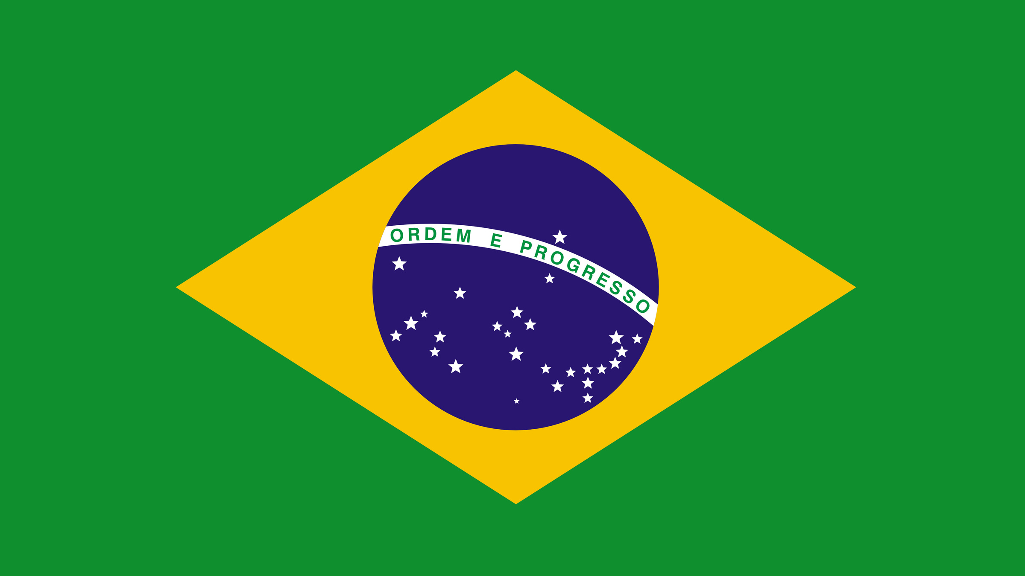

BRAZIL
the
therapeutic
BRAZIL IS A COUNTRY IN SOUTH AMERICA, IS LARGEST AND EASTERNMOST COUNTRY.
resource
platform

Slide 23
ADCAAN
the
therapeutic
resource
platform

Slide 24
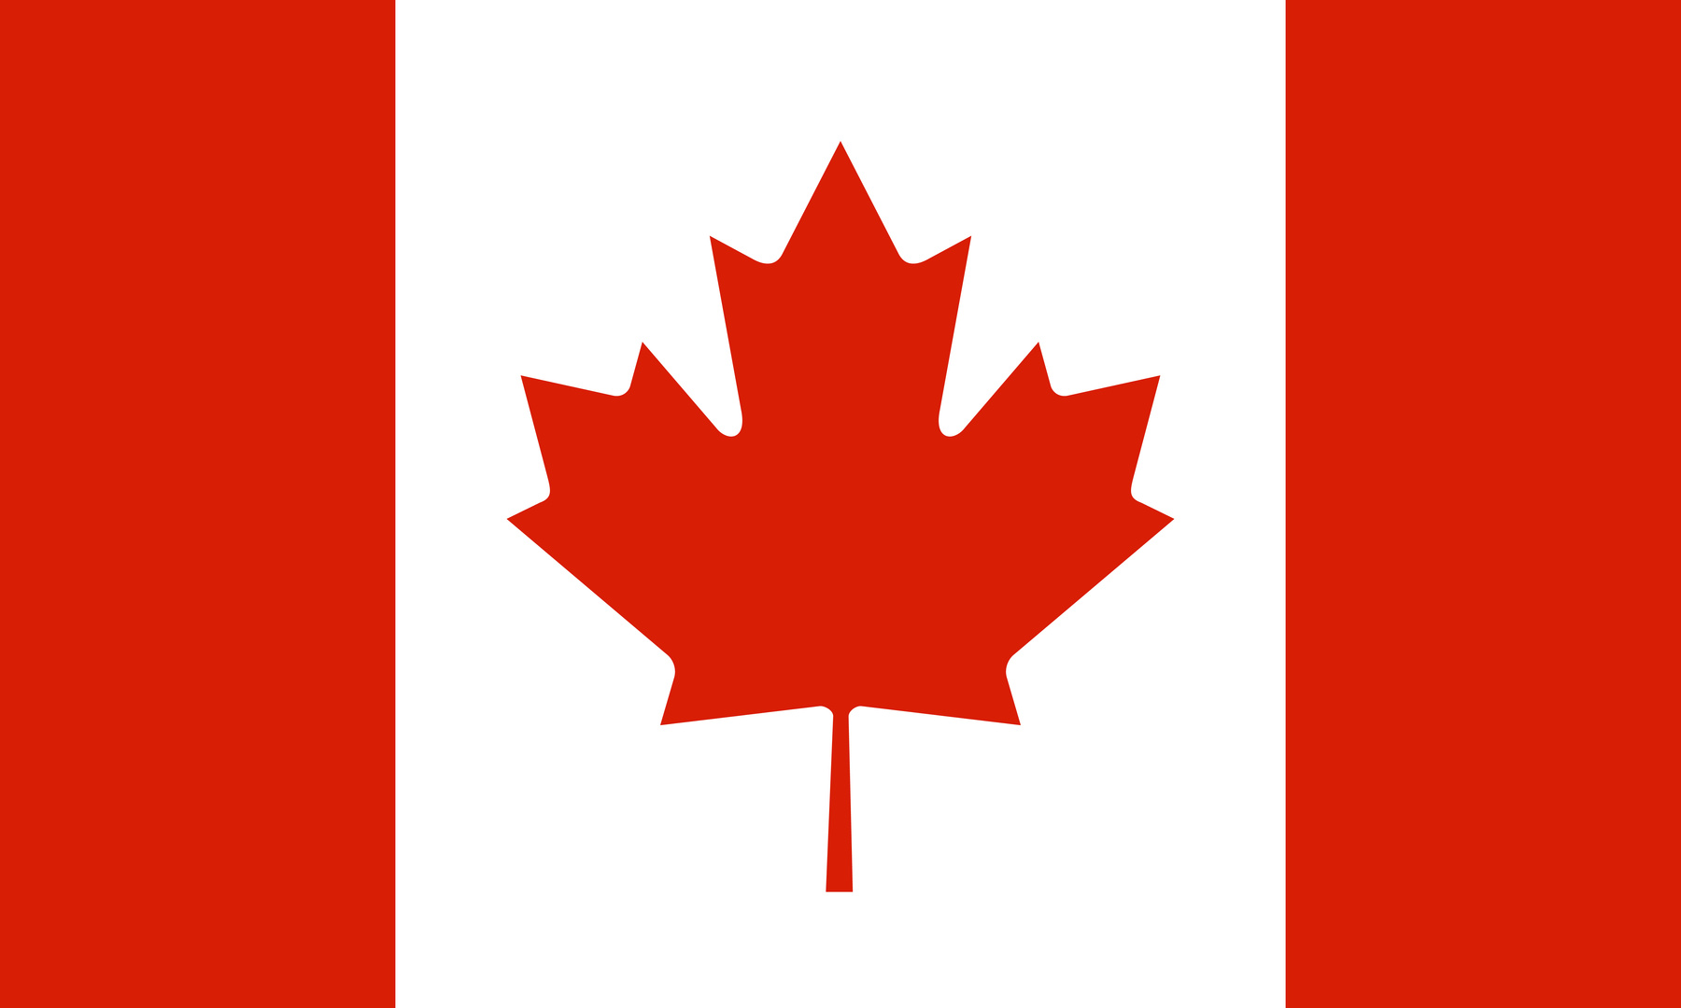

CANADA
the
therapeutic
resource
CANADA IS A COUNTRY IN NORTH AMERICA
platform

Slide 25
LPGORAUT
the
therapeutic
resource
platform

Slide 26
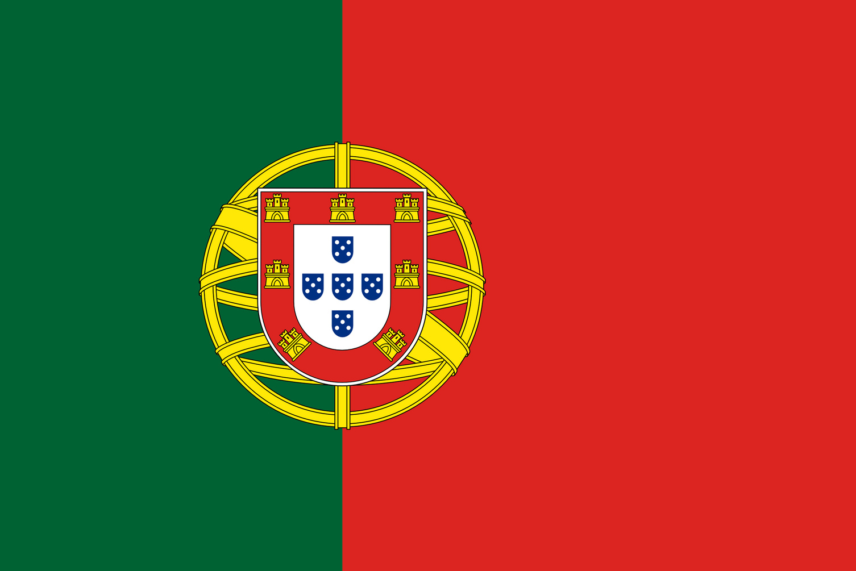

PORTUGAL
the
therapeutic
resource
CANADA IS A COUNTRY IN NORTH AMERICA.
platform

Slide 27
ATQRA
the
therapeutic
resource
platform

Slide 28


QATAR
the
therapeutic
resource
QATAR IS A COUNTRY IN THE MIDDLE EAST.
platform

Slide 29
WEABMBIZ
the
therapeutic
resource
platform

Slide 30


ZIMBABWE
the
therapeutic
resource
platform
ZIMBABWE IS A LANDLOCKED COUNTRY IN SOUTHERN AFRICA.

Slide 31
TEYGP
the
therapeutic
resource
platform

Slide 32


EGYPT
the
therapeutic
resource
EGYPT IS A COUNTRY LINKING NORTHEAST AFRICA WITH THE MIDDLE EAST.
platform

Slide 33
IANHC
the
therapeutic
resource
platform

Slide 34


CHINA
the
therapeutic
resource
platform
CHINA IS A COUNTRY IN EAST ASIA.

Slide 35
NRAI
the
therapeutic
resource
platform

Slide 36
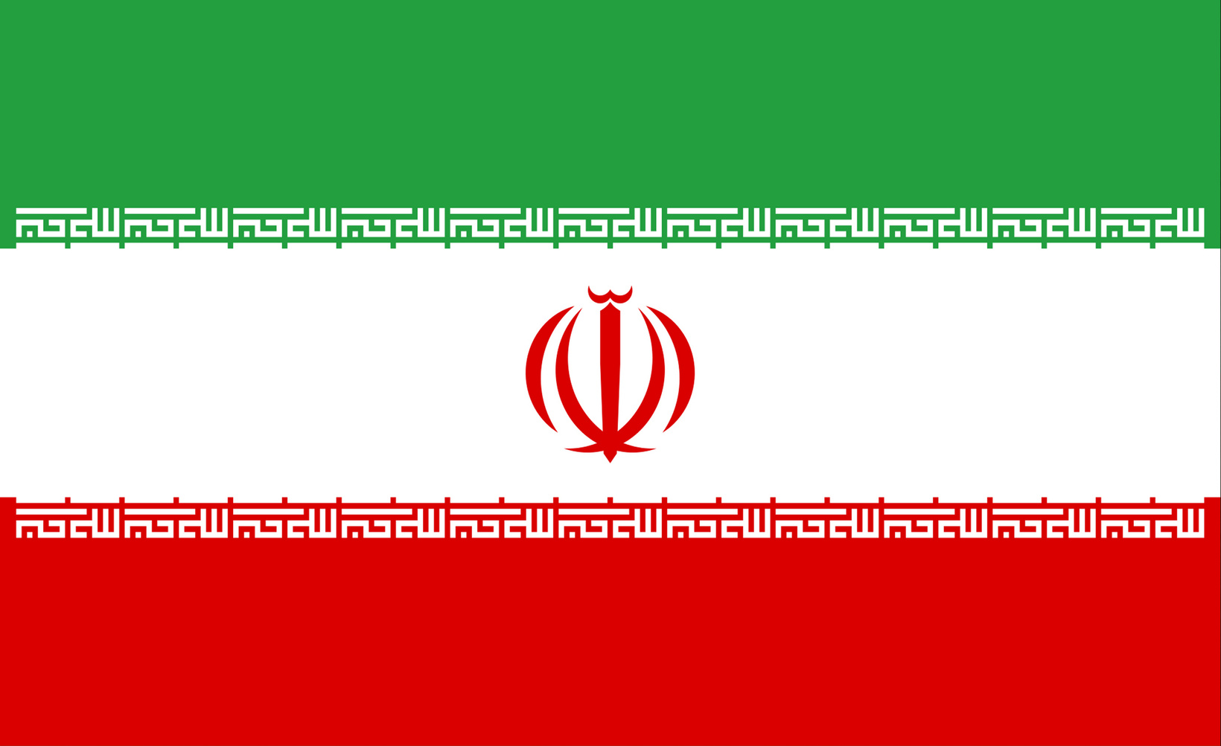

IRAN
the
therapeutic
resource
platform
IRAN IS COUNTRY IN WEST ASIA, ALSO KNOW AS PERSIA.

Slide 37
AIRSUS
the
therapeutic
resource
platform

Slide 38
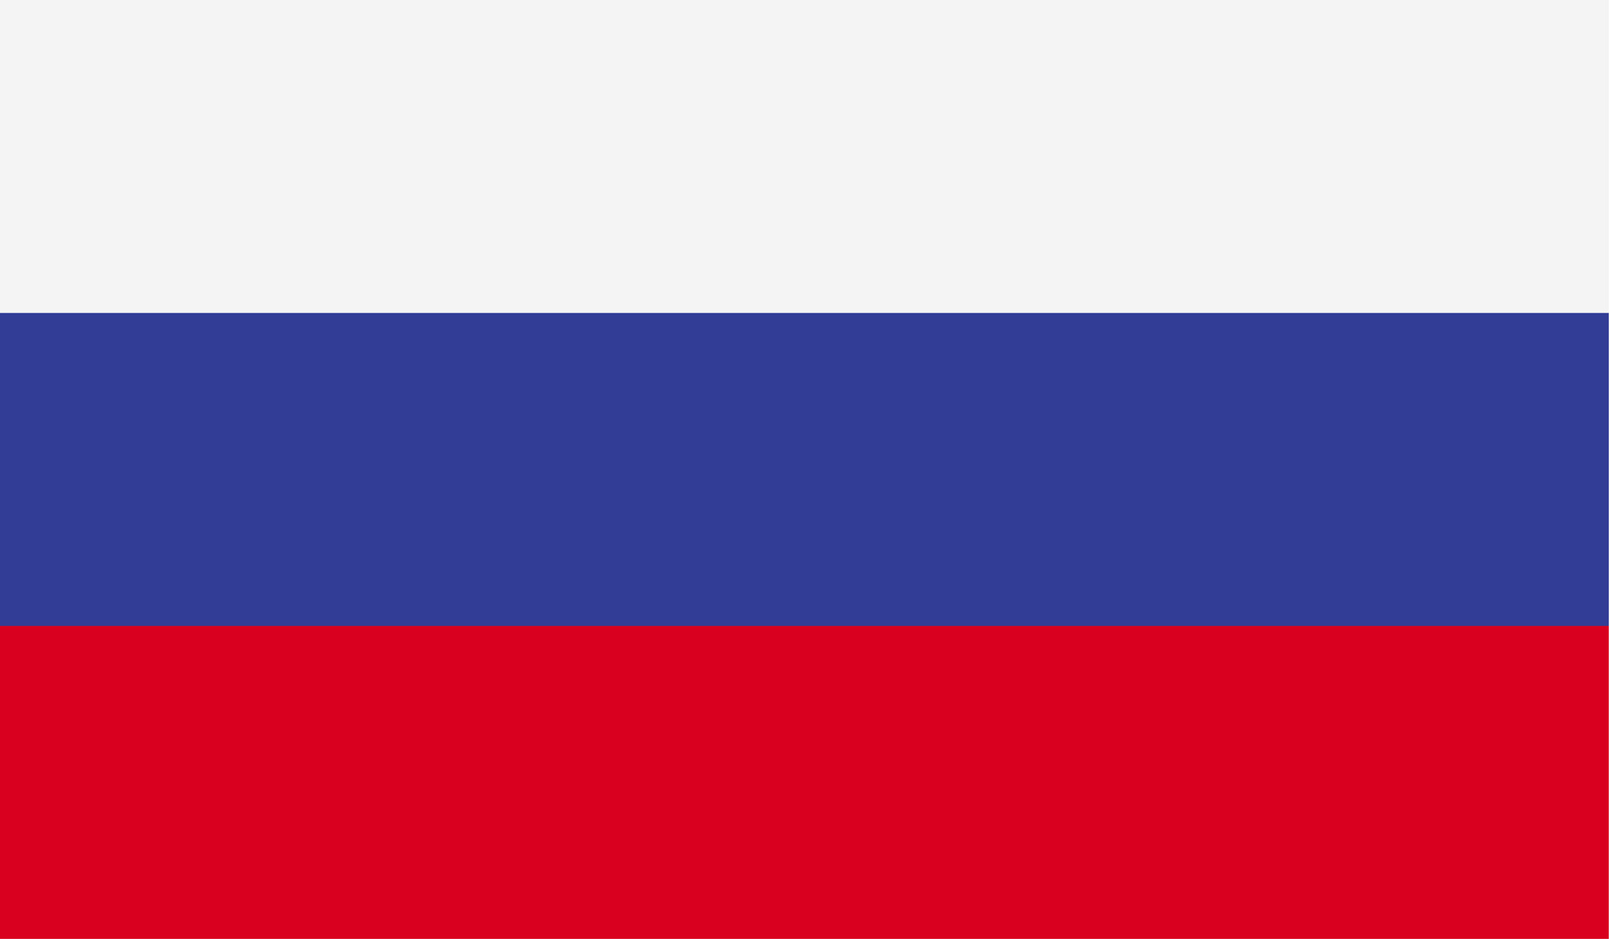

RUSSIA
the
therapeutic
RUSSIA IS A COUNTRY SPANNING EASTERN EUROPE AND NORTH ASIA.
resource
platform

Slide 39
DALNNIF
the
therapeutic
resource
platform

Slide 40


FINLAND
the
therapeutic
FINLAND IS A COUNTRY IN NORTHERN EUROPEAN BORDERING SWEDEN, NORWAY AND RUSSIA.
resource
platform

Slide 41
MEIVTNA
the
therapeutic
resource
platform

Slide 42
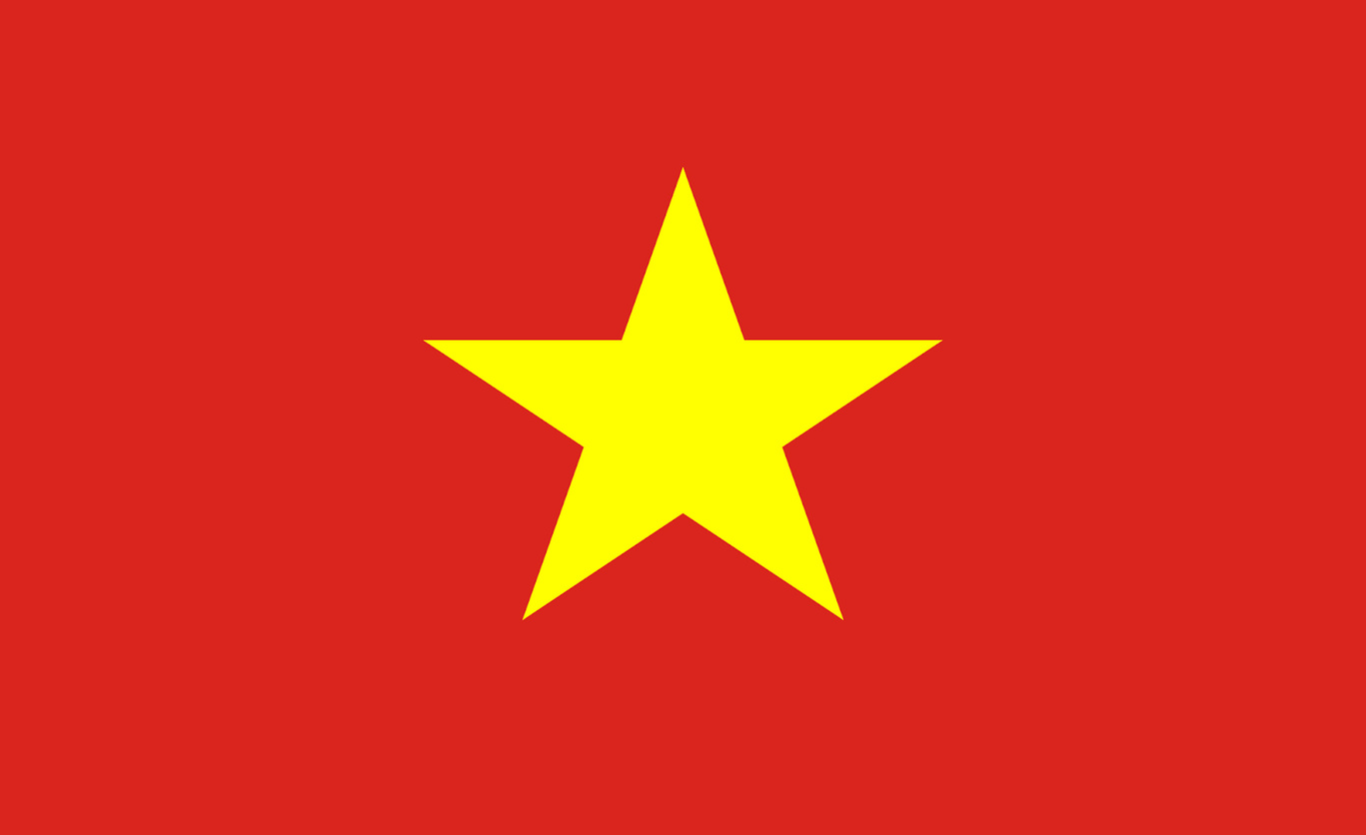

VIETNAM
the
therapeutic
resource
VIETNAM IS A COUNTRY IN A SOUTHEAST ASIAN.
platform

