Slide 1

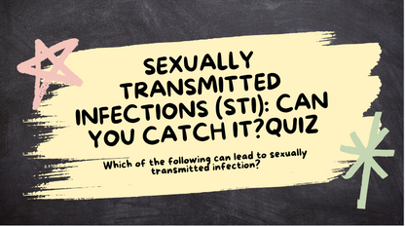
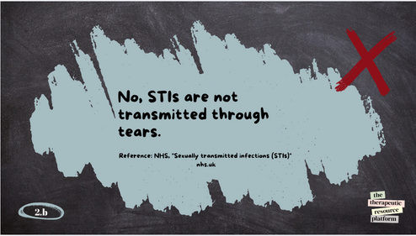
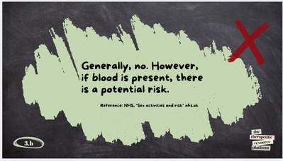








Sexually Transmitted Infections (STI): Can You Catch it?
Instruction page
Activity Type
General Activity Info
Age: 13-18+
Participation Style: Interactive group activity
Group play - solo points
1-1 task (adaptive)
This activity is designed to educate participants on the transmission routes of sexually transmitted infections (STIs) by having them guess whether certain actions can lead to an STI
This interactive activity helps participants understand the risks associated with the transmission of sexually transmitted infections (STIs). Participants review words or scenarios and sort them into categories: "Risk of Transmission" or "No Risk of Transmission." Through group discussions and facilitator-led explanations, participants gain valuable knowledge about STI prevention and dispel common myths.
Theme:
Sexual heath
Life skills
Materials Needed
  Download the slideshow for a digital session.
  Flashcards for participants to display their answers.
  Alternatively, you can print and laminate the resources, allowing participants to sort them into two categories: "Risk of Transmission" and "No Risk of Transmission."
Step By Step Instructions
  Present each action/slide to the participants.
  Ask participants to decide whether the action can lead to an STI transmission ("Yes" or "No").
  After each guess, reveal the correct answer and provide a brief explanation with references.
Discussion:
  Encourage participants to ask questions about each action.
  Clarify any misconceptions and provide additional information as needed.
Conclusion:
  Summarize key points about STI transmission routes.
  Emphasize the importance of safe practices to prevent STI transmission.
**You can also have participants sort the terms into "Risk" and "No Risk of Transmission." To do this, print and laminate the slides for reusable, hands-on engagement.
the
therapeutic
resource
platform
@reallygreatsite

Slide 2



SEXUALLY TRANSMITTED INFECTIONS (STI): CAN YOU CATCH IT?QUIZ
Which of the following can lead to sexually transmitted infection?

Slide 3


TOILET SEATS
the
therapeutic
1.a
resource
platform
@reallygreatsite

Slide 4


No - STI’s are not transmitted though toilet seats.
Reference: NHS, "Sexually transmitted infections (STIs)"
the
therapeutic
1.b
resource
platform
@reallygreatsite
Notes:
Reference: https://www.nhs.uk/conditions/sexually-transmitted-infections-stis/?utm_source=chatgpt.com

Slide 5


TEAR DROP
the
therapeutic
2.a
resource
platform
@reallygreatsite

Slide 6

No, STIs are not transmitted through tears.
Reference: NHS, "Sexually transmitted infections (STIs)"
nhs.uk
the
therapeutic
2.b
resource
platform
@reallygreatsite
Notes:
Reference:
https://www.nhs.uk/conditions/sexually-transmitted-infections-stis/

Slide 7


BITING OR SPITTING
the
therapeutic
3.a
resource
platform
@reallygreatsite

Slide 8

Generally, no. However, if blood is present, there is a potential risk.
Reference: NHS, "Sex activities and risk" nhs.uk
the
therapeutic
3.b
resource
platform
@reallygreatsite
Notes:
Reference:
https://www.nhs.uk/live-well/sexual-health/help-after-rape-and-sexual-assault/

Slide 9
FINGERING
the
therapeutic
4.a
resource
platform
@reallygreatsite

Slide 10

Yes, if there are cuts or sores on the fingers or genitals, there is a potential risk.
Reference: NHS, "Sex activities and risk" nhs.uk
the
therapeutic
4.b
resource
platform
@reallygreatsite
Notes:
Reference: https://www.nhs.uk/conditions/sexually-transmitted-infections-stis/?utm_source=chatgpt.com

Slide 11

SHARING CLOTHES
the
therapeutic
5.a
resource
platform
@reallygreatsite

Slide 12
No, STIs are not typically transmitted through sharing clothes.
Reference: NHS, "Sex activities and risk" nhs.uk
the
therapeutic
5.b
resource
platform
@reallygreatsite
Notes:
Reference: https://www.livehealthily.com/sexual-health/sexual-activities-risk

Slide 13
SHARING SEX TOYS, DILDOS OR VIBRATORS
the
6.a
therapeutic
resource
platform
@reallygreatsite

Slide 14
Yes, sharing uncleaned sex toys can transmit STIs.
Reference: NHS, "Sexually transmitted infections(STIs)" nhs.uk
the
therapeutic
6.b
resource
platform
@reallygreatsite
Notes:
Reference:
https://www.nhs.uk/conditions/sexually-transmitted-infections-stis/

Slide 15
SHARING TOWELS
the
therapeutic
7.a
resource
platform
@reallygreatsite

Slide 16
No, STIs are not typically transmitted through sharing towels.
Reference: NHS, "Sex activities and risk" nhs.uk
the
therapeutic
7.b
resource
platform
@reallygreatsite
Notes:
Reference: https://www.livehealthily.com/sexual-health/sexual-activities-risk

Slide 17


TOUCHING OR KISSING OOZING OR WEEPING BLISTERS OR SORES
the
therapeutic
8.a
resource
platform
@reallygreatsite

Slide 18

Yes, if the blister is caused by oral herpes (HSV-1), it can be transmitted through kissing.
Reference: NHS, "Sexually transmitted infections(STIs)" nhs.uk
the
therapeutic
8.b
resource
platform
@reallygreatsite
Notes:
Reference: https://www.nhs.uk/conditions/sexually-transmitted-infections-stis/

Slide 19
BEDDING
the
therapeutic
9.a
resource
platform
@reallygreatsite

Slide 20
No, STIs are not typically transmitted through sharing bedding.
Reference: NHS, "Sexually transmitted infections (STIs)"
the
therapeutic
9.b
resource
platform
@reallygreatsite
Notes:
Reference: https://www.nhs.uk/conditions/sexually-transmitted-infections-stis/?utm_source=chatgpt.com

Slide 21
SHARING CUPS AND CUTLERY ETC.
the
therapeutic
10.a
resource
platform
@reallygreatsite

Slide 22
No, STIs are not transmitted through sharing cutlery.
Reference: NHS, "Sexually transmitted infections(STIs)" nhs.uk
the
therapeutic
10.b
resource
platform
@reallygreatsite
Notes:
Reference:
https://www.nhs.uk/conditions/sexually-transmitted-infections-stis/

Slide 23
MASTURBATION
the
11.a
therapeutic
resource
platform
@reallygreatsite

Slide 24
No, masturbation does not transmit STIs.
Reference: NHS, "Sex activities and risk" nhs.uk
the
therapeutic
11.b
resource
platform
@reallygreatsite
Notes:
Reference: https://www.livehealthily.com/sexual-health/sexual-activities-risk

Slide 25

TANSMITABLE
the
therapeutic
resource
platform
@reallygreatsite

Slide 26

NOT TRANSMITABLE
the
therapeutic
resource
platform
@reallygreatsite

Slide 27

UNSURE
the
therapeutic
resource
platform
@reallygreatsite

