Slide 1

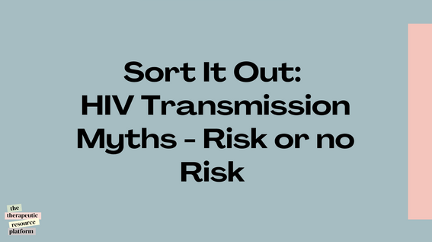
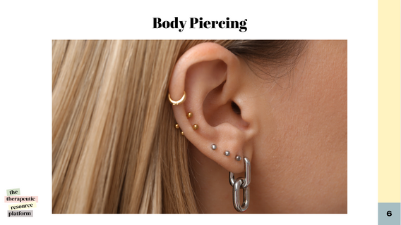








Sort It Out: HIV Transmission Myths - Risk or no Risk
Instruction page
Activity Type
General Activity Info
Age: 13-18+
Theme:
Informative
Interactive
Participation Style:
Group activity
1-1 activity activity
Group play - solo points
HIV is an important topic that need to be learnt about and disscussed. in this actyviity, participants will learn and identify ways HIV is and is not transmitted by sorting images into two categories; Risk of HIV transmission and no risk of HIV transmission, an unsure pile can also be used.
Challenge Level
MODRATE
Materials Needed
  A printed version of the resource, including the category labels for sorting. Laminating the materials is recommended for repeated use.
  A large table or open floor space is available for the activity.
  This activity can also be used in its slideshow format. You can use flashcards to collect responses or invite participants to share their answers aloud.
Step by Step Instructions
  Introduction (5-10 minutes): Briefly explain how HIV is transmitted and clarify common misconceptions. Discuss key concepts like:
    Transmission through blood, semen, vaginal fluids, rectal fluids, and breast milk.
    The importance of distinguishing between risky behaviours and harmless interactions.
  Sorting Activity (15-20 minutes)
    Print the resource out and laminate the pages.
    Spread out the image cards in a random pile.
    Ask participants to pick up one image at a time and decide whether to place it under "Risk" or "No Risk or Unsure”
    For each choice, the participant must explain their reasoning. they can also do this in groups and give feedback to the broader team at the end of the timer.
  Discussion (10 minutes):
    Review all choices as a group.
    Provide corrections and explanations where necessary.
Reflection Questions:
  What surprised you most during this activity?
  What myths about HIV transmission were debunked?
  How can this knowledge help reduce the stigma around people living with HIV?
the
therapeutic
resource
platform
@reallygreatsite

Slide 2
Sort It Out:
HIV Transmission Myths - Risk or no Risk
the
therapeutic
resource
platform
@reallygreatsite

Slide 3

African People
the
therapeutic
resource
1
platform
@reallygreatsite

Slide 4

Mother To Baby
the
therapeutic
resource
2
platform
@reallygreatsite

Slide 5

Gay Men
the
therapeutic
resource
3
platform
@reallygreatsite

Slide 6
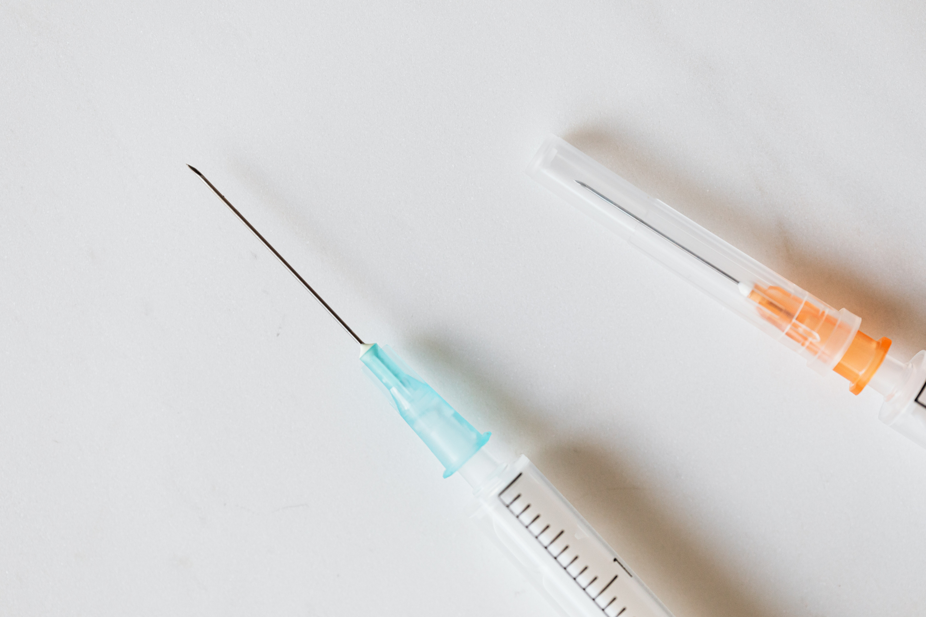
Sharing Needle
the
therapeutic
resource
4
platform
@reallygreatsite

Slide 7
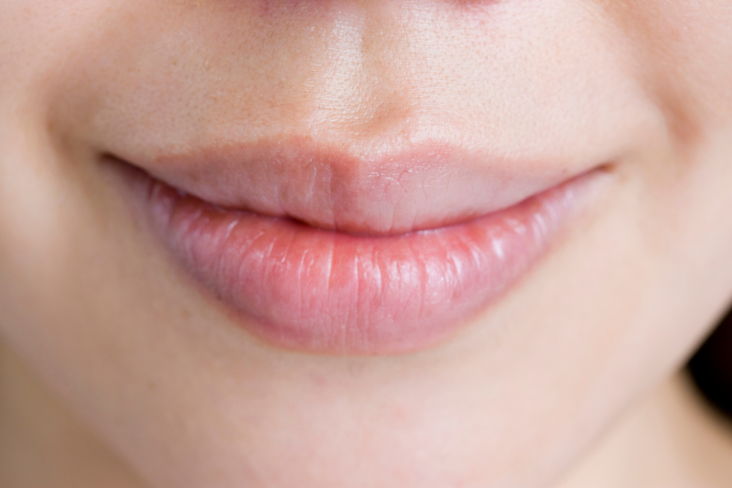
Oral Sex
the
therapeutic
resource
5
platform
@reallygreatsite

Slide 8
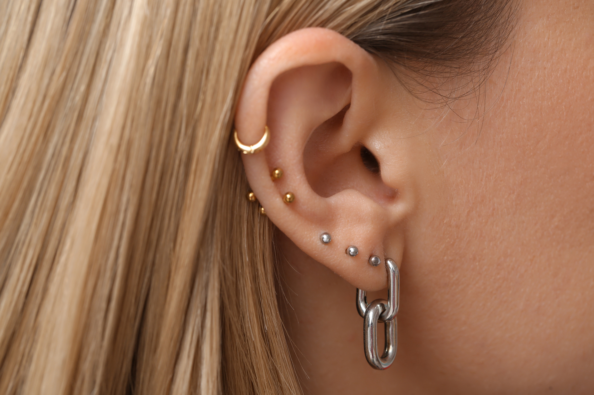
Body Piercing
the
therapeutic
resource
6
platform
@reallygreatsite

Slide 9

Providing Personal Care
the
therapeutic
resource
7
platform
@reallygreatsite

Slide 10

The Elderly
the
therapeutic
resource
8
platform
@reallygreatsite

Slide 11
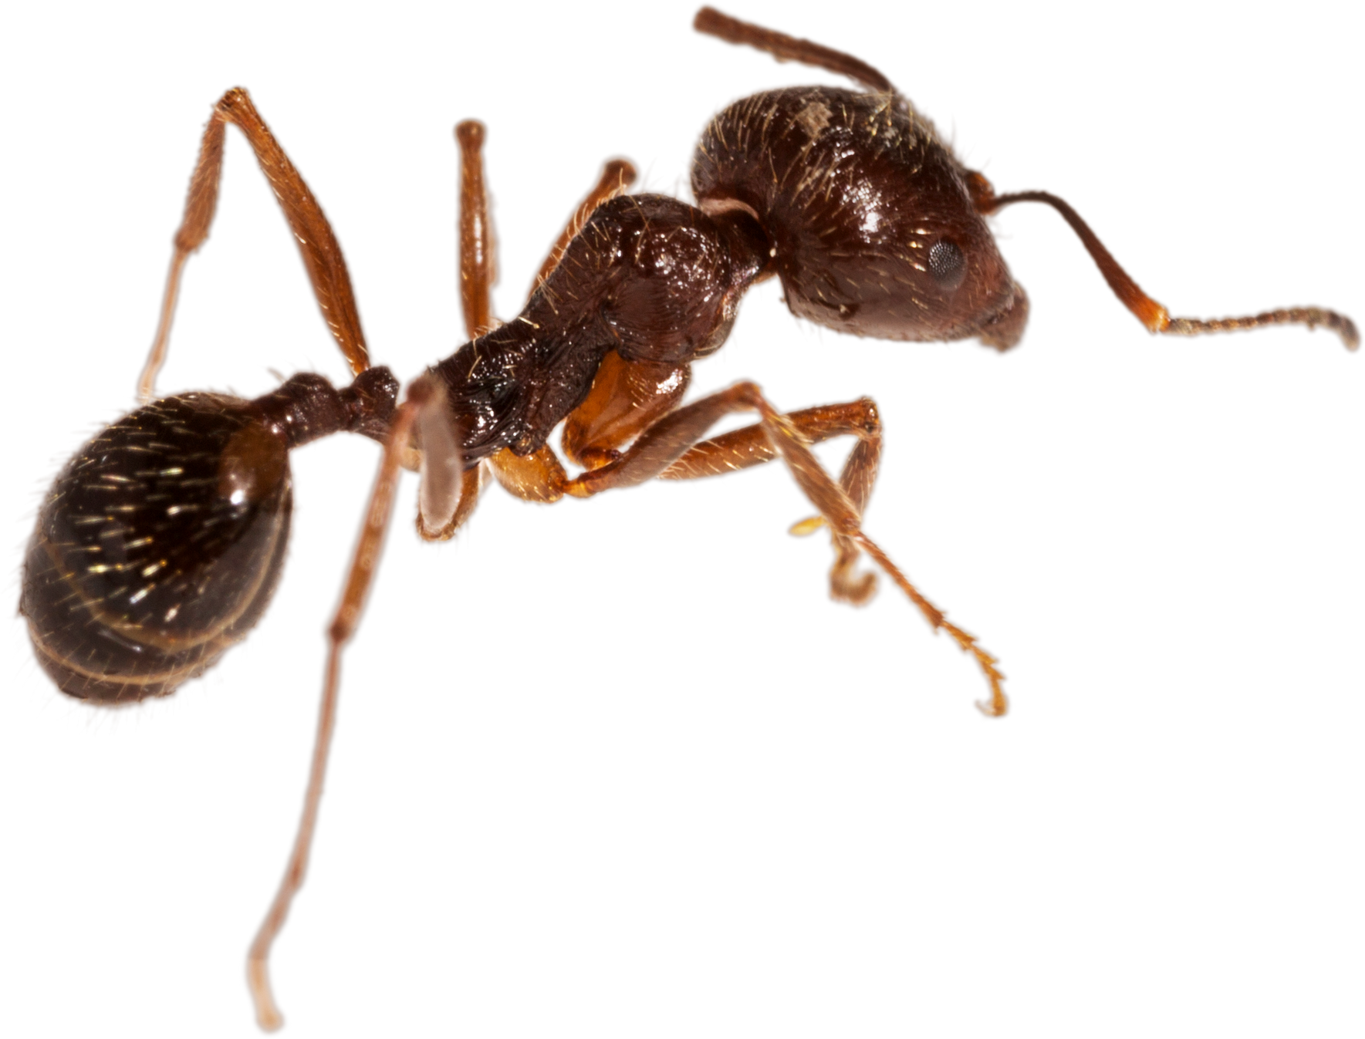
Insect Bites
the
therapeutic
resource
9
platform
@reallygreatsite

Slide 12

Unprotected Sex
the
therapeutic
resource
10
platform
@reallygreatsite

Slide 13

Swimming In A Public Pool
the
therapeutic
resource
11
platform
@reallygreatsite

Slide 14
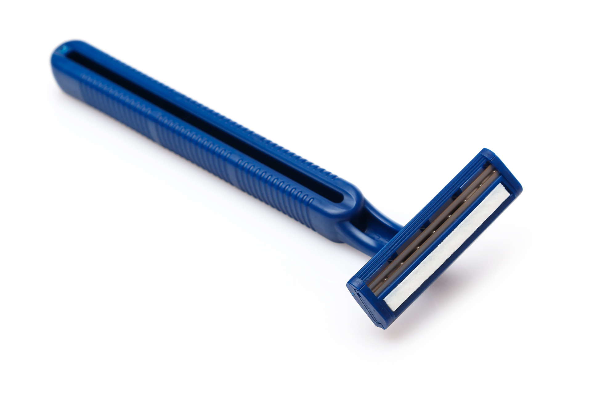
Sharing Razors
the
therapeutic
resource
12
platform
@reallygreatsite

Slide 15

kissing
the
therapeutic
resource
13
platform
@reallygreatsite

Slide 16


Getting A Tatoo
the
therapeutic
resource
14
platform
@reallygreatsite

Slide 17

Sex Workers (Prostitute)
the
therapeutic
resource
15
platform
@reallygreatsite

Slide 18

Holding Hands
the
therapeutic
resource
16
platform
@reallygreatsite

Slide 19
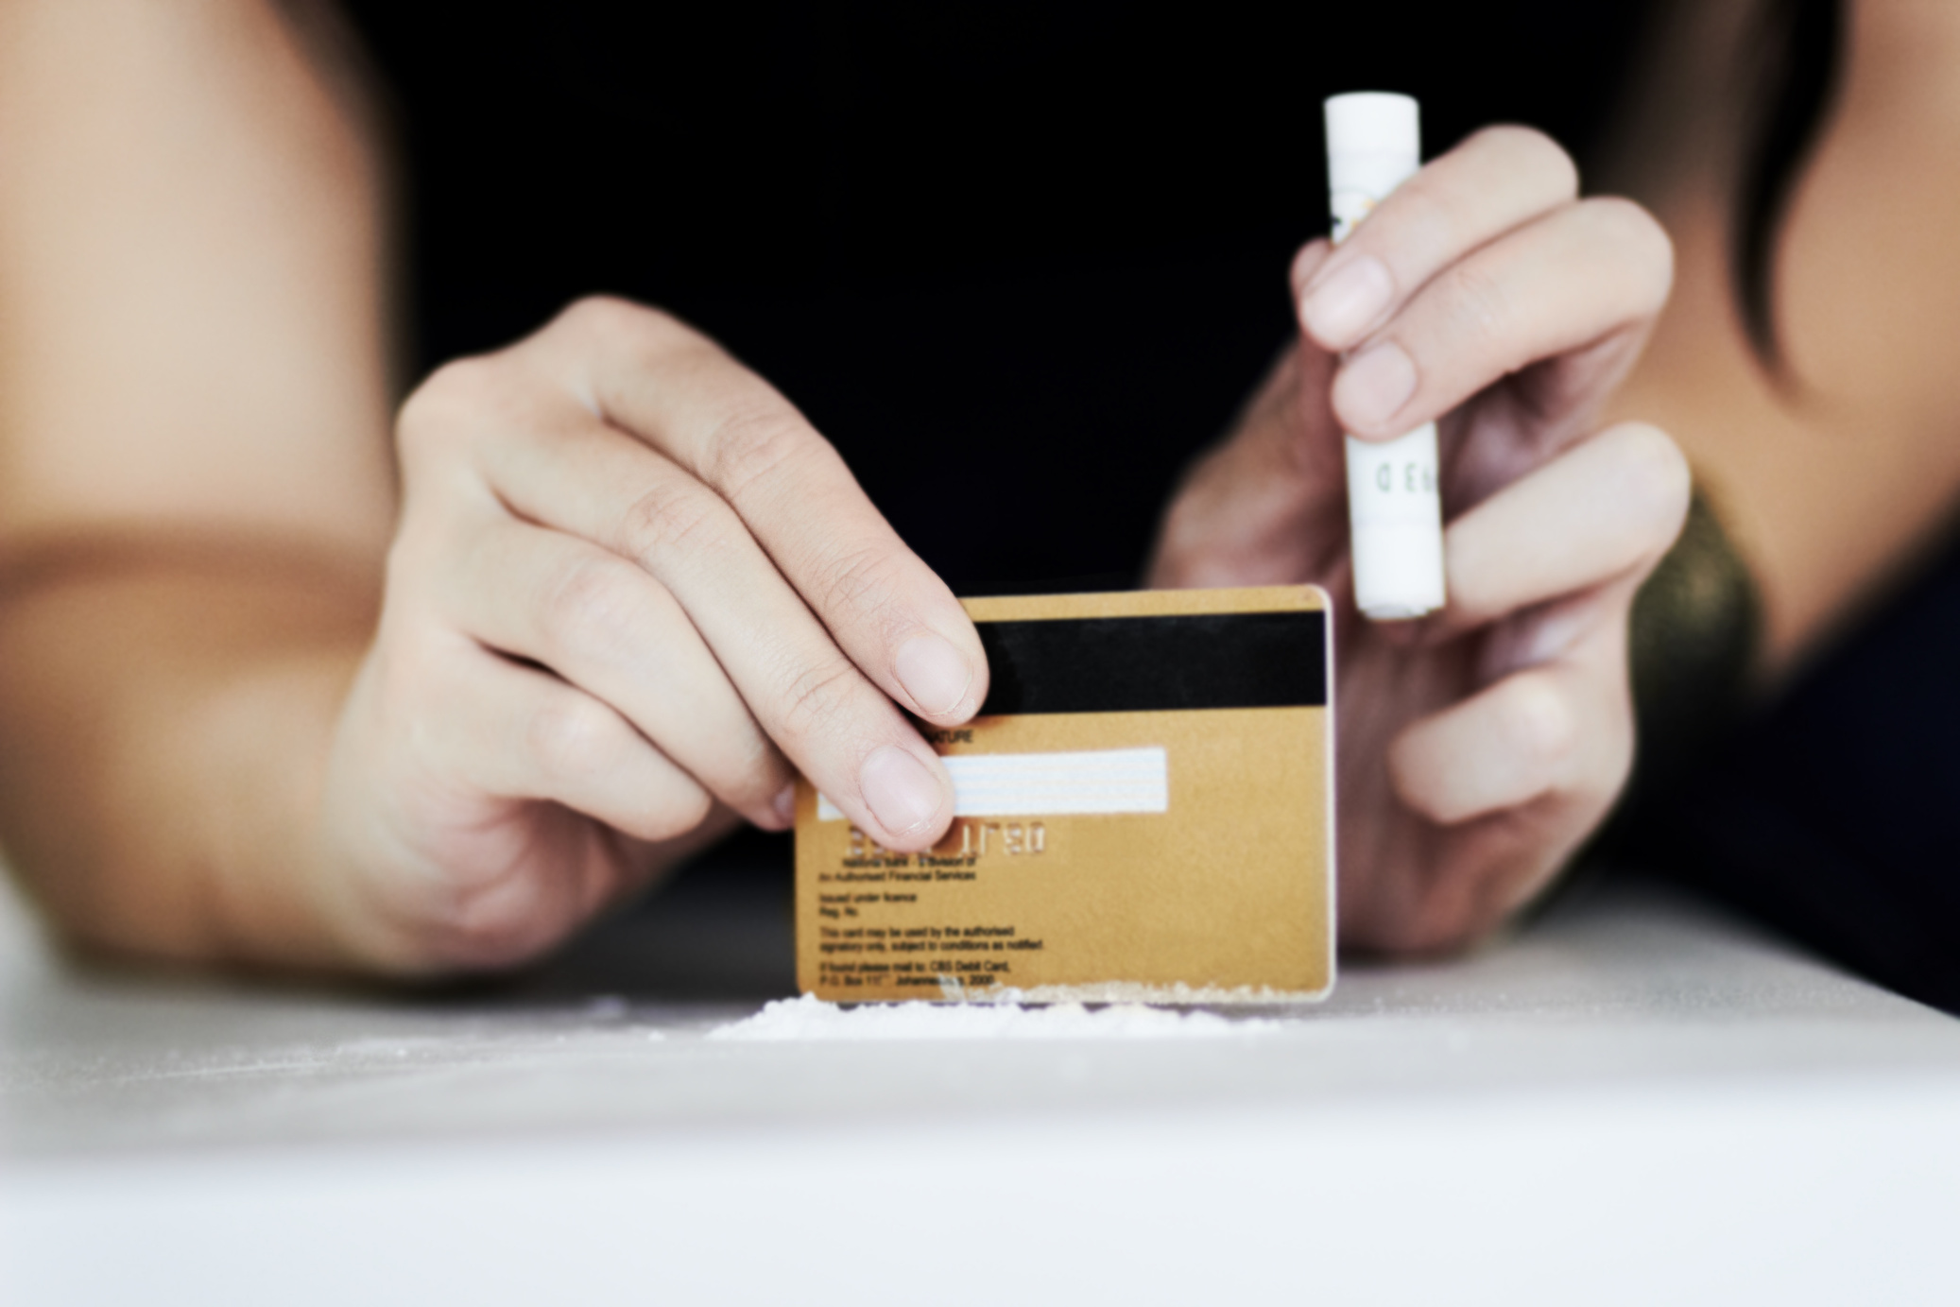
Sharing Of Stawsnotes
(Cocaine Use)
the
therapeutic
resource
17
platform
@reallygreatsite

Slide 20
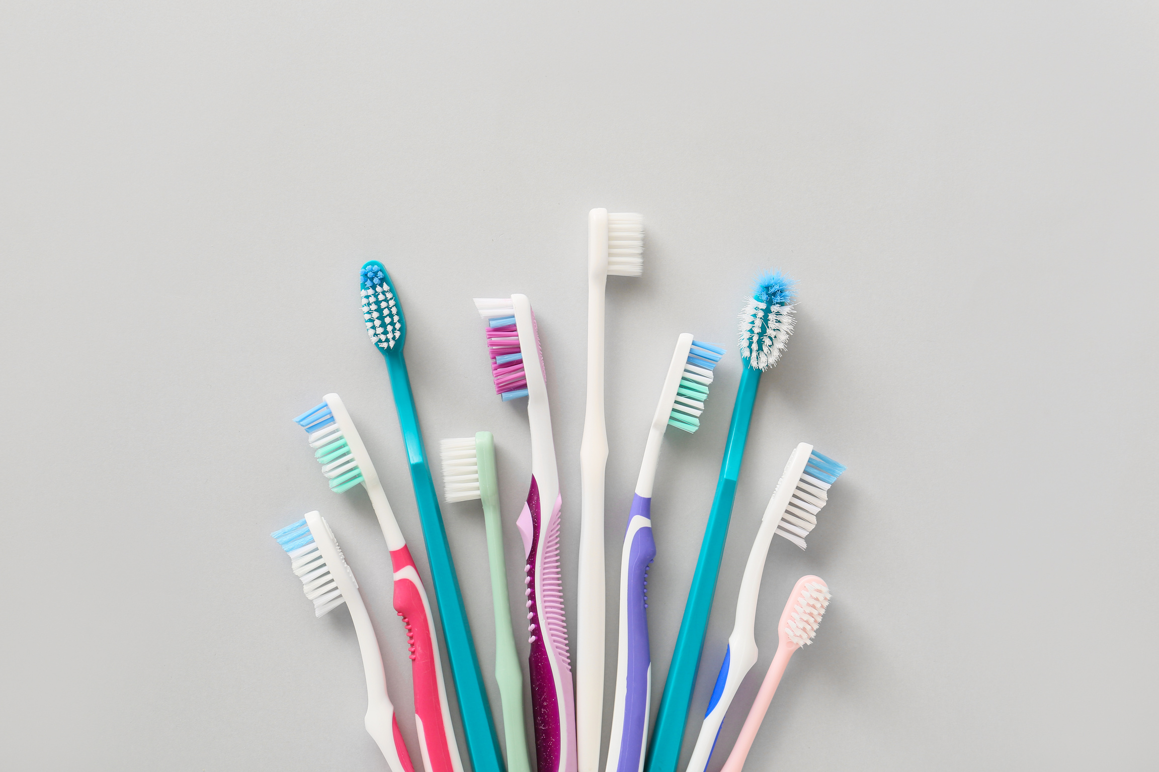
Sharing Toothbrush
the
therapeutic
resource
18
platform
@reallygreatsite

Slide 21
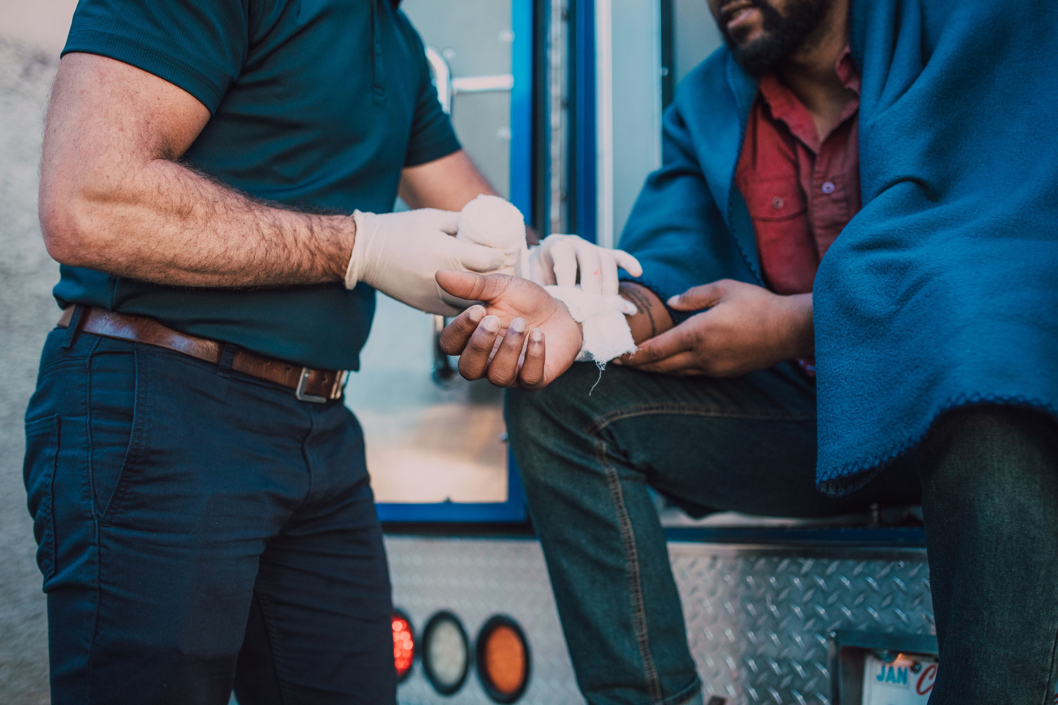
First Aid
the
therapeutic
resource
19
platform
@reallygreatsite

Slide 22
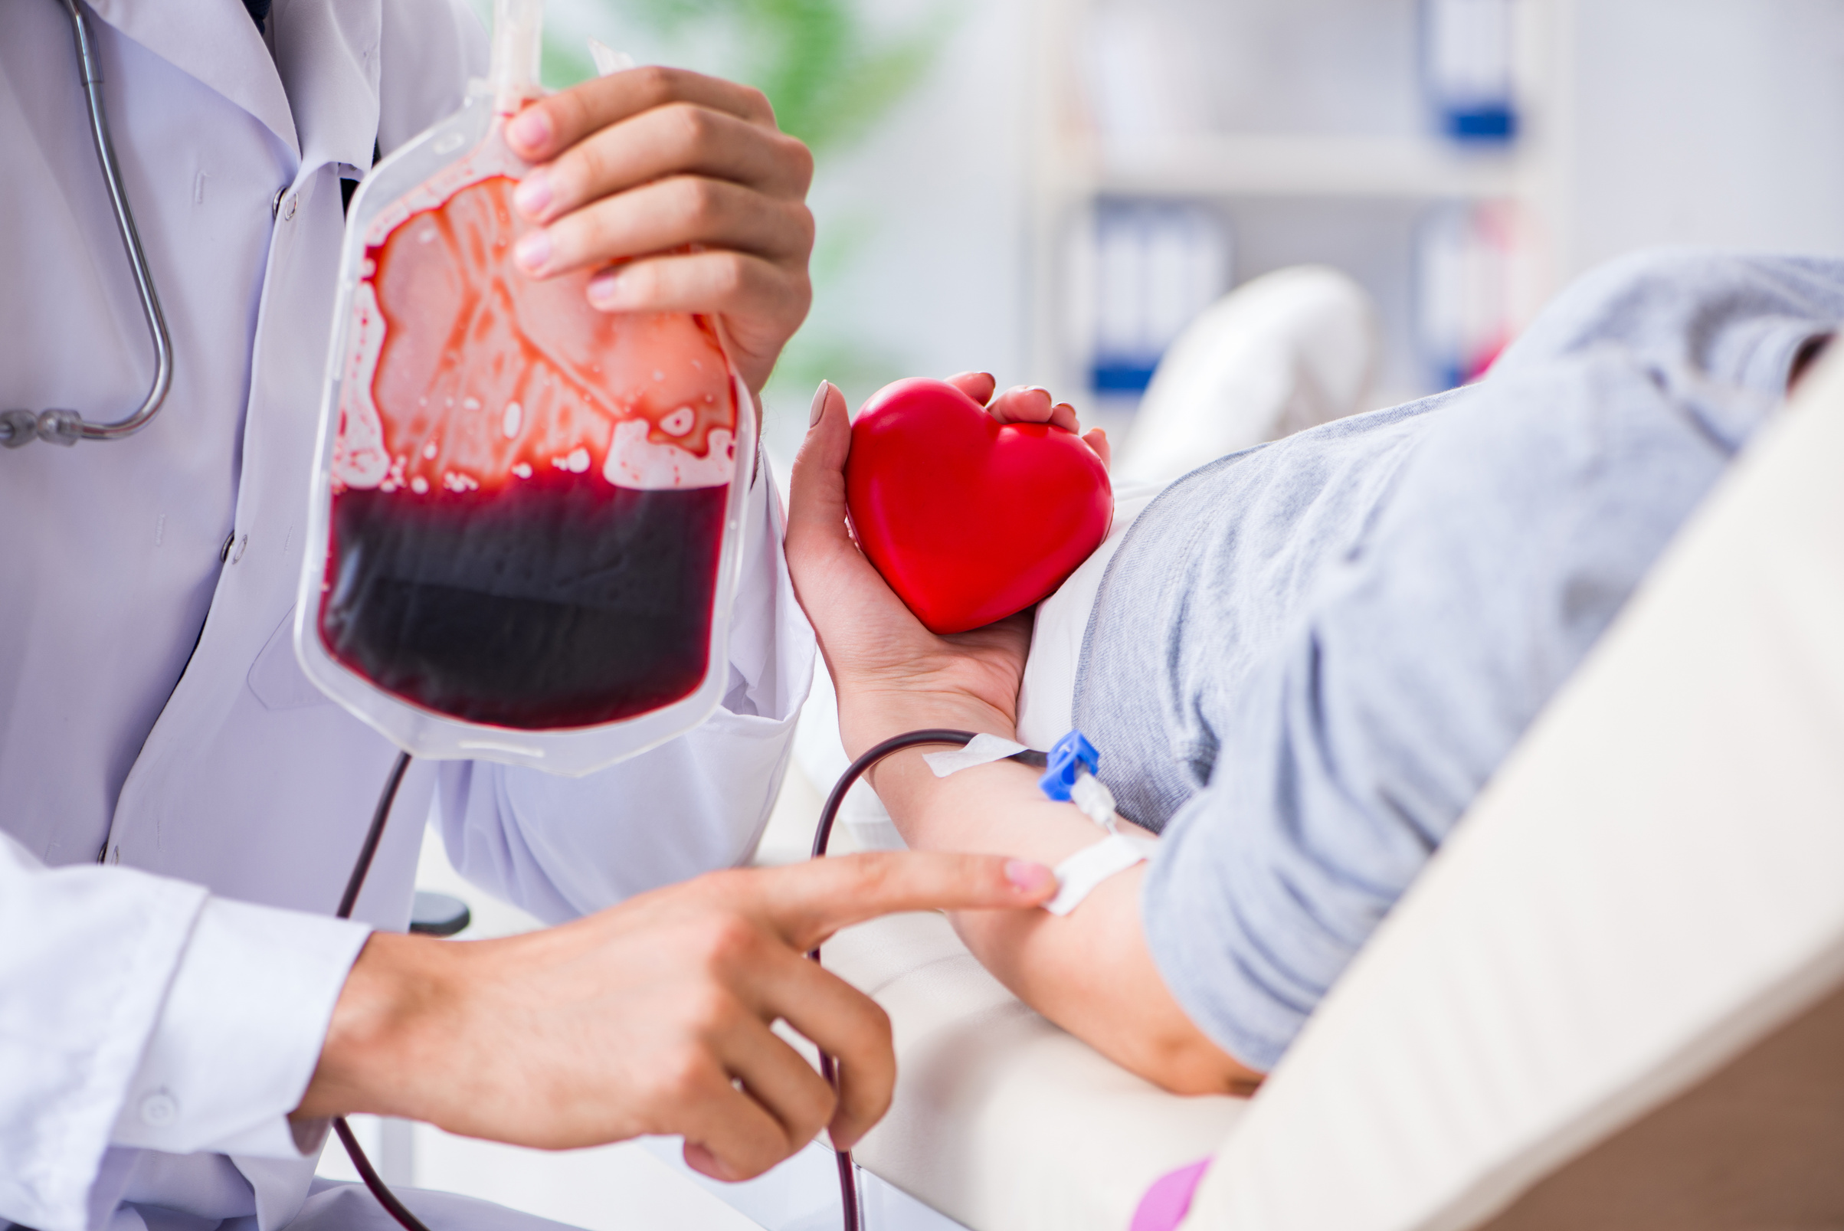
Blood Transfusion
the
therapeutic
resource
20
platform
@reallygreatsite

Slide 23
Risk of HIV Transmission
the
therapeutic
resource
platform
@reallygreatsite

Slide 24
No Risk of HIV Transmission
the
therapeutic
resource
platform
@reallygreatsite

Slide 25
Unsure if there is a Risk of HIV Transmission
the
therapeutic
resource
platform
@reallygreatsite

Slide 26

Page Number | Name | Risk of transmission? | Notes
1 | African people | No Risk | HIV is transmitted through bodily fluids, such as blood, semen, vaginal fluids, and breast milk. Ethnicity is not a factor in transmission.
2 | Mother to baby | Risk | A mother living with HIV can transmit the virus to her baby, primarily during childbirth rather than pregnancy, as the mother's and baby's blood are usually separate in utero. Effective interventions, including antiretroviral therapy (ART) and appropriate prenatal care, have reduced the mother-to-child transmission rate to less than 0.5% in the UK (Public Health England, 2016). Early diagnosis and proper medical care are essential to protect the baby’s health (British HIV Association, 2022).
3 | Gay Men | Risk | Anyone can contract HIV, regardless of sexual orientation. However, HIV is more prevalent in certain communities, particularly among men who have sex with men (MSM) due to higher rates of unprotected sex, multiple partners, and a higher likelihood of encountering anal sex, which carries a higher risk of transmission. Education, prevention, and access to treatment are crucial for all communities. (NHS, "HIV and AIDS")
4 | Sharing Needle | Risk | Sharing needles is a risk for HIV transmission. HIV is a virus that attacks the immune system, and it can be transmitted through contact with infected blood. 2 Sharing needles can expose you to infected blood, which can increase your risk of contracting HIV.
5 | Oral Sex | Risk | Oral sex can transmit HIV, although the risk is lower than with vaginal or anal sex.The UK National Health Service (NHS) states that while the risk of HIV transmission through oral sex is lower than through vaginal or anal sex, it is still possible.
6 | Body Piercing | No Risk | Body piercing does carry some risks, including infection and allergic reactions. While rare, there is a very small risk of transmitting blood-borne infections like HIV through improperly sterilized equipment. It's crucial to get piercings from reputable studios that adhere to strict hygiene and safety standards. The UK's Public Health England provides guidance on safe body piercing practices.
7 | Providing Personal Care | No Risk | Providing personal care generally poses a low risk for HIV transmission. HIV spreads through specific bodily fluids, not through casual contact. However, it's important to be aware of potential risks and take necessary precautions.
8 | The Elderly | No Risk | HIV is transmitted through bodily fluids, such as blood, semen, vaginal fluids, and breast milk. Age is not a factor in transmission.
9 | Insect Bites | No Risk | No, insect bites cannot transmit HIV. HIV is primarily transmitted through bodily fluids such as blood, semen, and vaginal fluids. 2 Insect bites do not involve the exchange of these fluids. For more information, you can refer to resources from the UK National Health Service (NHS), such as their website or helpline.
Answers
Page 1 of 3
the
therapeutic
resource
platform
@reallygreatsite

Slide 27
Page Number | Name | Risk of transmission? | Notes
10 | Unprotected Sex | Risk | Unprotected sex is a risk for transmitting HIV. HIV is a virus that attacks the immune system. It can be transmitted through unprotected sex, sharing needles, or from mother to child during pregnancy, childbirth, or breastfeeding.There is no cure for HIV, but there are treatments that can help people with HIV live long and healthy lives.
11 | Swimming In A Public Pool | No Risk | Swimming in a public pool is not a risk for HIV transmission. HIV is not spread through water or casual contact, even in the UK. HIV is primarily transmitted through specific bodily fluids, such as blood, semen, vaginal fluids, and breast milk, and typically through sexual contact or sharing needles.
12 | Sharing Razors | Risk | Sharing razors can pose a risk of transmitting HIV, although the risk is generally low.there is a risk of HIV transmission if you share a razor with someone who has HIV. This is because HIV can be transmitted through blood, and it is possible for blood to get on a razor if the person using it nicks themselves. If you then use the same razor and also nick yourself, you could be at risk of contracting HIV.
13 | kissing | No Risk | Kissing is generally considered a low-risk activity for transmitting HIV. However, it's not entirely risk-free. Here's a breakdown. HIV is primarily transmitted through specific bodily fluids, such as blood, semen, vaginal fluids, and breast milk, and typically through sexual contact or sharing needles.
14 | Getting A Tatoo | Risk | Getting a tattoo carries a risk of HIV transmission, though it is considered a risk of contracting HIV from a tattoo is extremely low, provided that the tattoo is done in a licensed and reputable tattoo parlor. This is because licensed tattoo artists in the UK are required to adhere to strict hygiene regulations, which include: Using sterile equipment for each client Disposing of needles and other sharps in designated containers Maintaining a clean and sanitary environmet
15 | Sex Workers (Prostitute) | Risk | Sex workers are at a higher risk of contracting HIV than the general population due to a variety of factors, including: Increased exposure: Sex workers often have multiple sexual partners, which increases their risk of exposure to HIV. Stigma and discrimination: Stigma and discrimination can lead to sex workers being marginalized and less likely to access healthcare services, including HIV testing and treatment. Criminalization: In many countries, sex work is criminalized, which can drive sex workers underground and make it difficult for them to access healthcare and other support services. Poverty and economic vulnerability: Poverty and economic vulnerability can force sex workers to engage in risky sexual behaviors in order to survive.
Answers
Page 2 of 3
the
therapeutic
resource
platform
@reallygreatsite

Slide 28
Page Number | Name | Risk of transmission? | Notes
16 | Holding Hands | No Risk | Holding hands is not a risk for HIV transmission. HIV is primarily transmitted through specific bodily fluids, such as blood, semen, vaginal fluids, and breast milk. 2 Casual contact, like holding hands, does not pose a risk.
17 | Sharing Of Stawsnotes (Cocaine Use) | No Risk | Sharing stewnote does not pose a risk for HIV transmission. HIV is primarily transmitted through specific bodily fluids, such as blood, semen, vaginal fluids, and breast milk. Sharing food or drinks, including stewnote, does not involve these fluids and therefore carries no risk of HIV transmission.
18 | Sharing Toothbrush | No Risk | Sharing a toothbrush carries a theoretical risk of HIV transmission, but in practice, it's considered very low. HIV cannot survive for long outside the body, and the amount of blood on a toothbrush is usually minimal.
19 | First Aid | No Risk | Providing first aid is generally safe and does not pose a significant risk of HIV transmission.there are some risks associated with first aid, but the benefits of providing timely and appropriate care generally outweigh the potential risks. Here are some of the potential risks associated with first aid
20 | Blood Transfusion | No Risk | The risk of contracting HIV through a blood transfusion in the UK is extremely low. This is because all donated blood in the UK has been screened for HIV since 1985.
Answers
Page 3 of 3
the
therapeutic
resource
platform
@reallygreatsite

