Slide 1

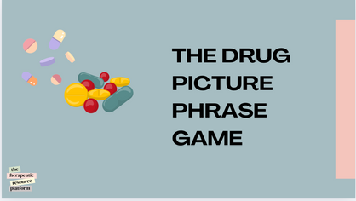









The Drug Picture Phrase Game: Ice breaker
Instruction page
Activity Type
General Activity Info
Challenge Level
MODRATE
Participation Style:
Team activity
Icebreaker activity
Shared play - solo points
This is a drug-related phrase riddle activity where participants use images to guess the associated word. All the words are linked to substance misuse.
It’s a great warm-up activity to introduce key terms that can be explored further during the session.
This activity requires the practitioner to have a solid understanding of substance misuse, as they will need to answer questions and provide accurate information. Our site offers a wealth of resources for practitioners to enhance their knowledge.
Theme:
Interactive
Icebreaker/starter activity
Age: 15-18+
Materials Needed
  Dowlode the slide show OR print coppies and laminate them for future use.
Step by Step Instructions
  Have the slideshow ready for use.
  Go through each slide and ask participants to provide the correct answer to the picture riddle.
  If you choose to print the images, distribute them on the table for participants to work in groups and figure out the answer.
  Discuss the answers with the group and provide additional context on the topic.
Top Tip: To make this activity easier, provide participants with the answers in a randomised order. thier task will be to match the phrase to the words given. This resource pack include a cut out version for your use.
the
therapeutic
resource
platform
@reallygreatsite

Slide 2

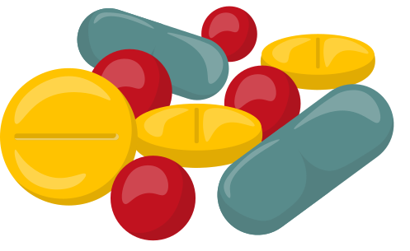
THE DRUG
PICTURE
PHRASE
GAME
the
therapeutic
resource
platform
@reallygreatsite

Slide 3
j o i n t
j o i n t
the
therapeutic
resource
platform
1
@reallygreatsite

Slide 4


the
therapeutic
resource
platform
2
@reallygreatsite

Slide 5



the
therapeutic
resource
platform
3
@reallygreatsite

Slide 6



the
therapeutic
resource
platform
4
@reallygreatsite

Slide 7
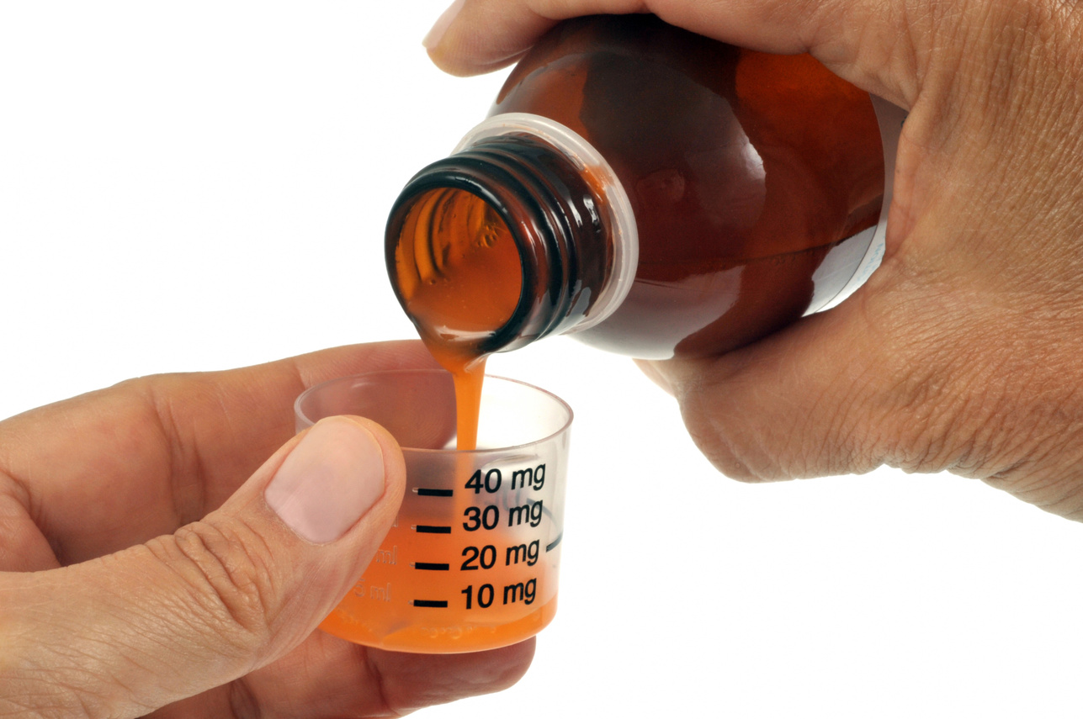

the
therapeutic
resource
platform
5
@reallygreatsite

Slide 8

I N
the
therapeutic
resource
platform
6
@reallygreatsite

Slide 9

Whitey
the
therapeutic
resource
platform
7
@reallygreatsite

Slide 10


Showing Love
the
Communication
therapeutic
resource
platform
8
@reallygreatsite

Slide 11


D
the
therapeutic
resource
platform
9
@reallygreatsite

Slide 12


the
therapeutic
resource
platform
10
@reallygreatsite

Slide 13

the
therapeutic
resource
platform
11
@reallygreatsite

Slide 14


the
therapeutic
resource
platform
12
@reallygreatsite

Slide 15

Page Number | Phrase Answer
1 | Roll a Joint
2 | Cold Turkey
3 | Mood Swing
4 | Cocaine
5 | Overdose
6 | Tripping
7 | Pull A Whitey
8 | Hangover
9 | Depressant
10 | Northern Light
11 | Withdrwal
12 | Addiction
Answer Sheet
the
therapeutic
resource
platform
11
@reallygreatsite

Slide 16
Hangover
Depressant
Tripping
Addiction
Northern Light
Roll a Joint
Cocaine
Pull A Whitey
Cold Turkey
Overdose
Withdrwal
Mood Swing

